Slide 1


Services for people with print disabilities
CELA offers FREE access to a collection of over 1.5 million books, magazines, and newspapers for people who have a print disability, and their educators, and support professionals.

Slide 2
What is a print disability?
A disability that makes it difficult for a person to read a traditional print book
For example:
  Learning Disability: An impairment relating to comprehension
  Physical Disability: Difficulty holding or turn pages of a book
  Visual Disability: Severe or total impairment of sight or the inability to focus or move one’s eyes

Slide 3
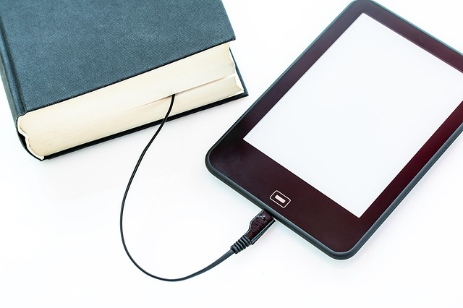
Who does that include?
Those with a disability that requires them to customize their reading experience to support understanding.
Examples include:
Adjusting text size or format on a computer, tablet, or e-reader
Using technology that supports limited mobility or alternative input methods
Reading in braille

Slide 4
Types of accounts
User Account – for those with a print disability
Educator Access Program – for Educators K-12, Educational Assistants, Early Childhood Educators, Post-Secondary Educators, and professionals who work in an educational institution
Client Access Program Account – for Professionals who work directly with people with a print disability (ex. Occupational Therapists, Speech-Language Pathologists, Long-Term Care Support professionals, etc.)

Slide 5
Benefits
Accessible digital books, magazines, and newspapers – without a waitlist
Choose your preferred format: audio, accessible e-text, or braille
Full range of subjects, genres, best sellers and award winners for all ages

Slide 6

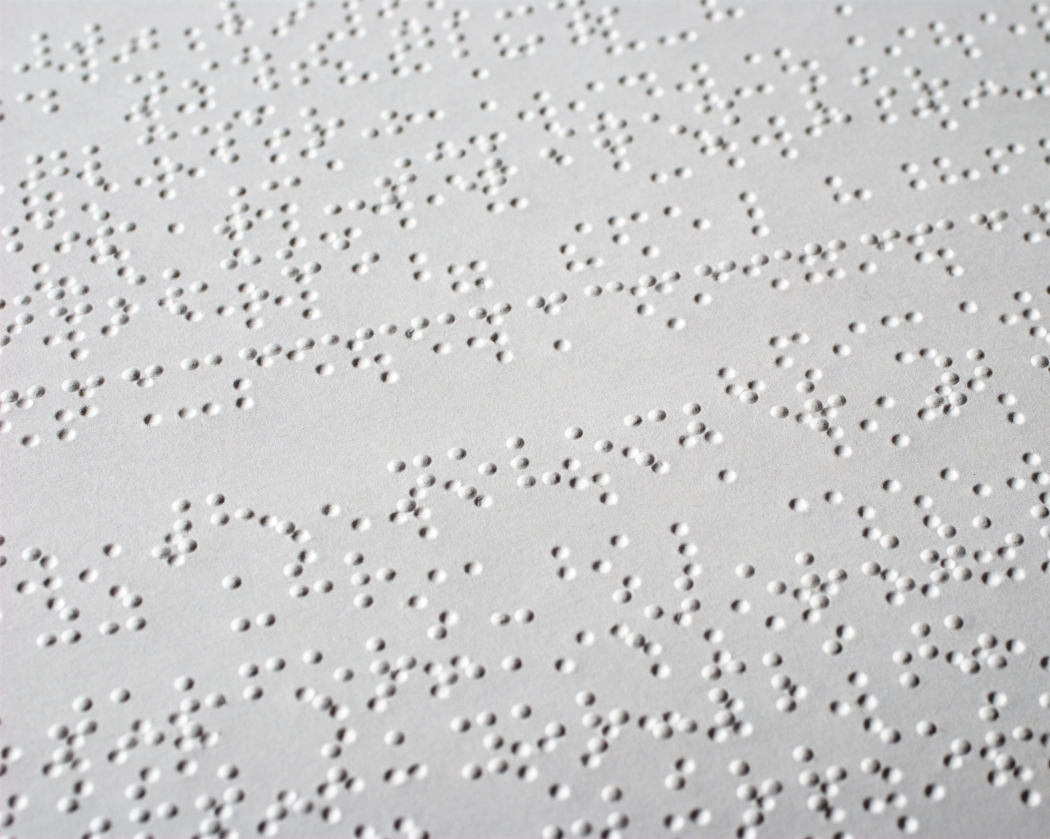
How to read
Smart phones, tablets, computers, and e-readers
DAISY players
Envoy Connect devices
Braille books
Braille display
Alexa smart speaker

Slide 7

Signing up for CELA
Visit celalibrary.ca to register
What you need:
Public library card
Self-declaration of a print disability for CELA services
Proof of diagnosis may be needed to access specific titles

